Slide 1

Pricing $tays in NYC for Ho$ts
Varsha Garla
Metis | August 2021 | Linear Regression & Web Scraping

Slide 2




Objective
Price
Features
Regression Model
Too high → loss
Property
Listing
Reasonable price
Too low → loss

Slide 3




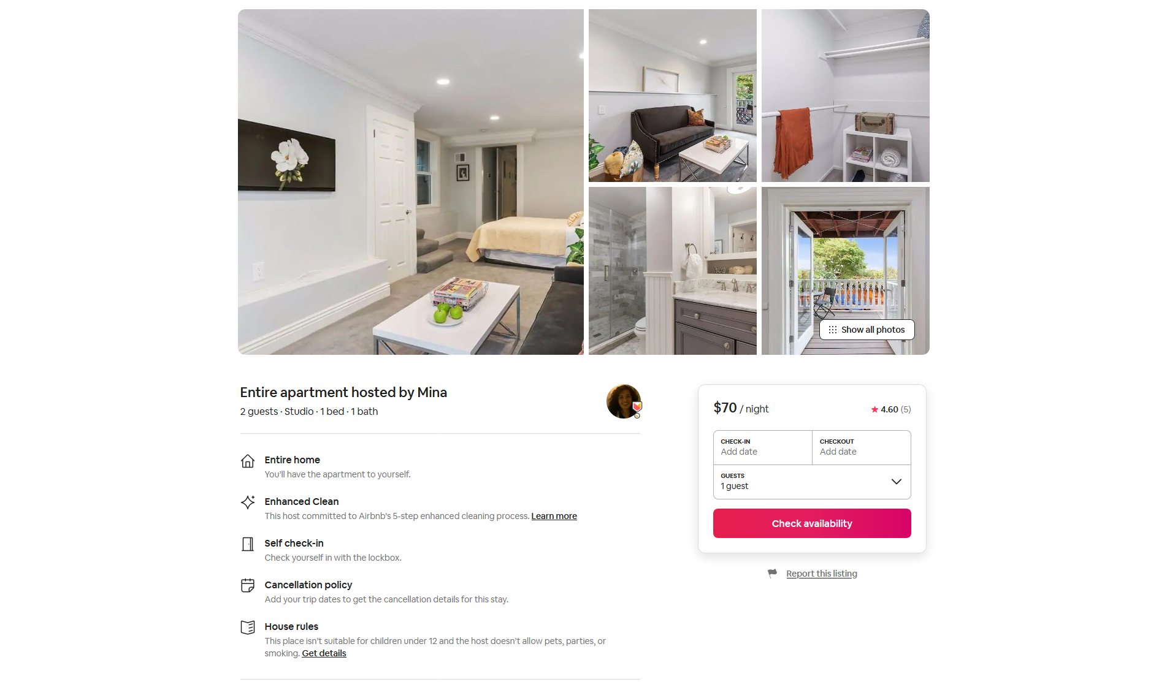


Workflow
Web Scraping
Data Cleaning & EDA
Regression
Prediction/Evaluation
Target:
Price per night

Slide 4

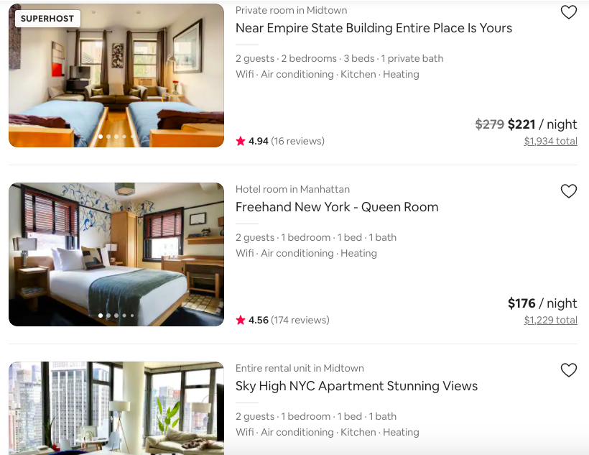
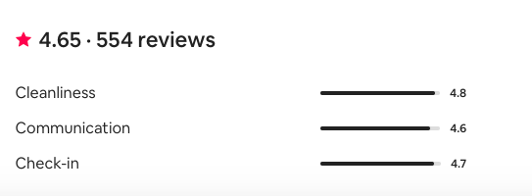
Data

Slide 5
RidgeCV
+ Deviation Feature: No. guests relative to borough
0.526
LassoCV
0.534
Modelling
0.530
+ Superhost
Validation R² Scores
+ Borough
0.522
$20
+ Property Type
0.522
Simple linear regression with numeric features
0.407
Underfitting at each step
Keep adding complexity
Baseline
0.290

Slide 6
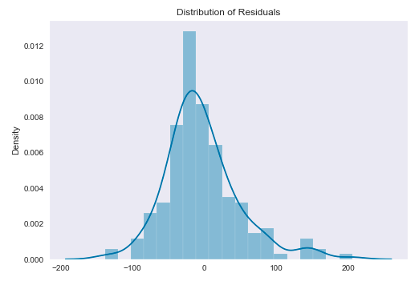
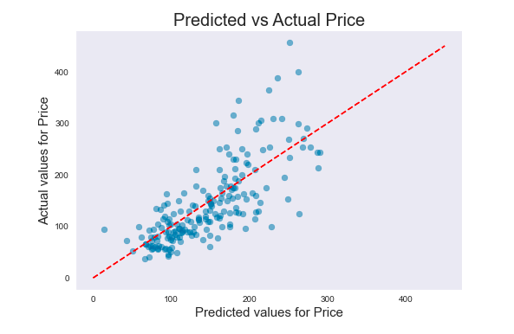
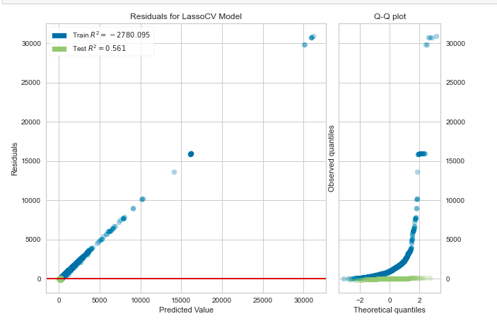
Final Model Performance
heteroskedasticity
R² on Holdout: 0.561
MAE: $38.47

Slide 7
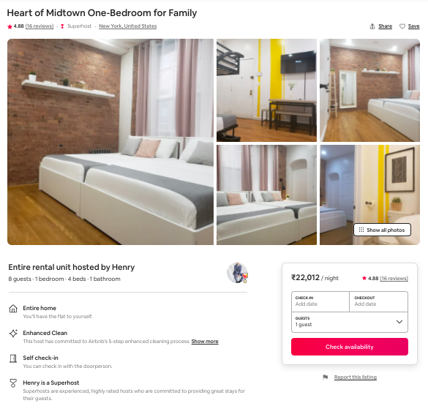
Final Model Performance
Actual: $456.00/night
Prediction: $250.84/night
-$205
MAE: $38.47

Slide 8
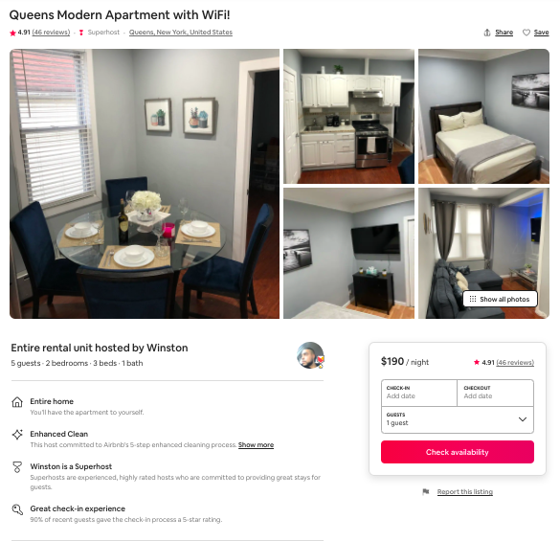
Final Model Performance
Actual: $194.00/night
Prediction: $180.93/night
-$13
MAE: $38.47

Slide 9
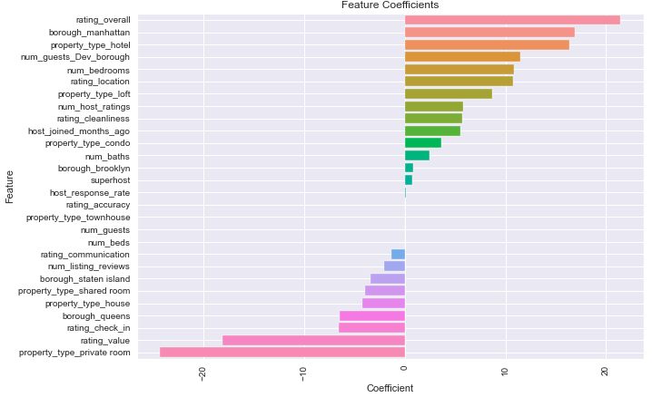
Importance of Features

Slide 10


Future Work
Time Series Analysis
Feature Engineering
NLP
Sentiments of reviews
Seasonality

Slide 11
Questions?
Thank you!

Slide 12

Appendix

Slide 13
Features
Numeric
Categorical
Engineered
Angel Around
Ratings
Overall, cleanliness, accuracy, communication, location, check-in, value
Host
Number of host ratings, host joined months ago, host response rate
Number of listing reviews
Size
Number of guests, number of bedrooms, number of beds, number of baths
Borough
Manhattan, Bronx, Brooklyn, Queens, Staten Island
Property Type
Apartment, condo, hotel, house, loft, private room, shared room, townhouse
Superhost
Deviation Feature
Number of guests (occupancy) relative to borough

Slide 14
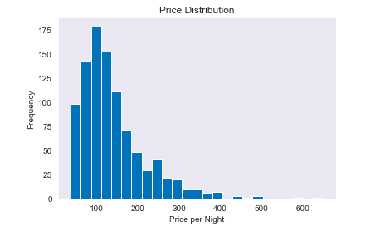
Target Distribution

Slide 15
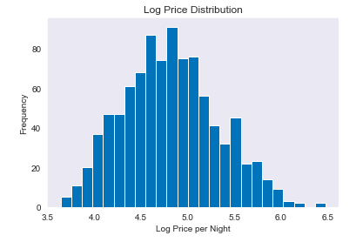
Target Distribution

Slide 16
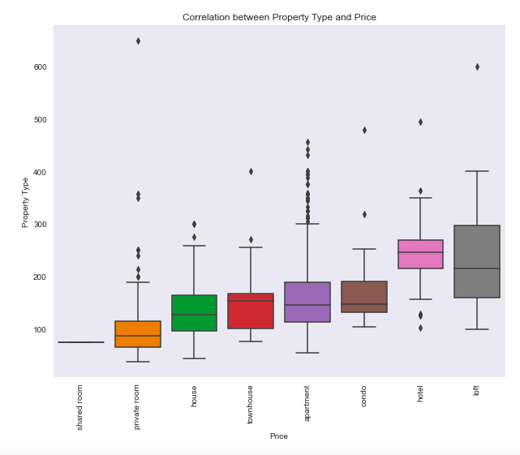

Slide 17
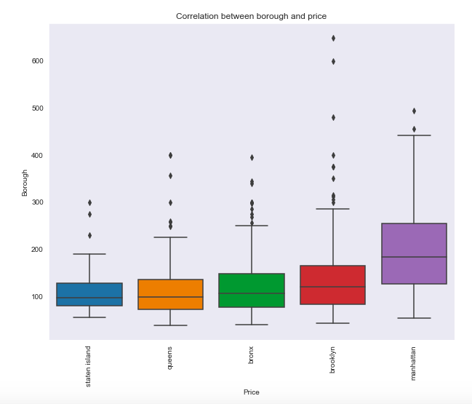

Slide 18
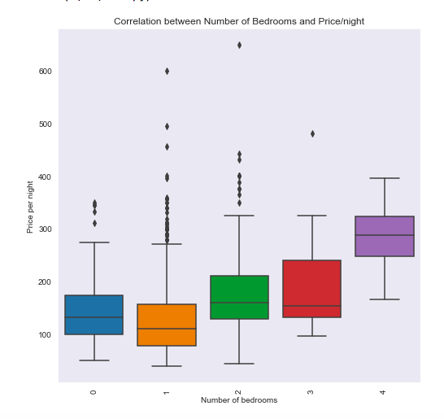

Slide 19
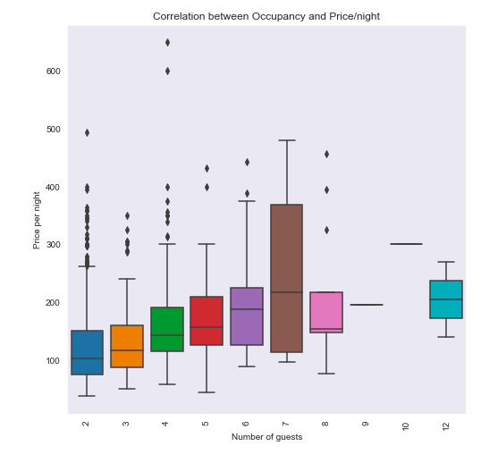

Slide 20
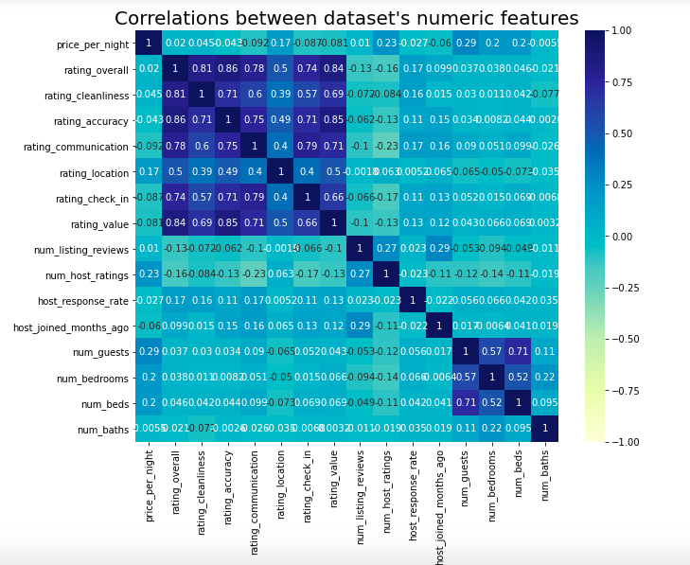

Slide 21
